Slide 1
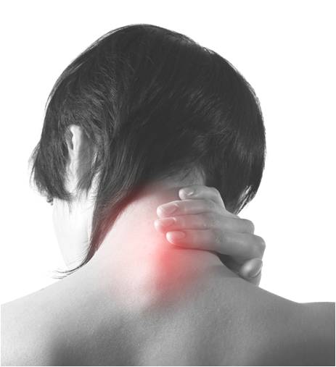


Magnetic resonance imaging of subjects with acute unilateral neck pain and restricted motion: a feasibility study
8th ICAOR, Milan, Italy, April, 2010
Gary Fryer, Ph.D., B.Sc.(Osteopathy),^{1,2} James Adams, D.O.³
¹A.T. Still Research Institute, A.T. Still University, Kirksville, MO, USA
² School of Biomedical & Health Sciences, Victoria University, Melbourne, Australia
³ Kirksville College of Osteopathic Medicine, Kirksville, MO, USA

Slide 2
Introduction
Palpation of soft tissue texture and subtle joint motion are considered important for the assessment of somatic dysfunction
Clinical indicators of dysfunction are said to be
  Tissue texture change
  Asymmetry
  Range of motion disturbance
  Tenderness
Greenman PE. Principles of Manual Medicine. 3rd ed. Philadelphia: Lippincott William & Wilkins; 2003
DiGiovanna EL, Schiowitz S, Dowling DJ. An Osteopathic Approach to Diagnosis & Treatment. 3rd ed. Philadelphia: Lippincott William & Wilkins; 2005
Notes:
A feasibility study is an evaluation of a proposal designed to determine the difficulty in carrying out a designated task.

Slide 3
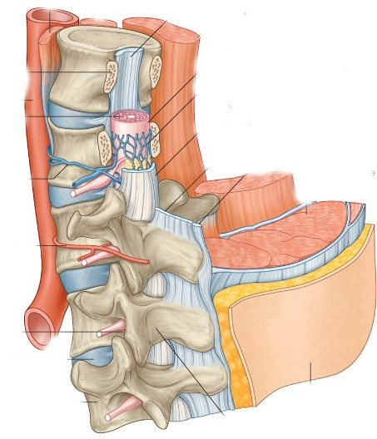
Etiology and pathophysiology of somatic dysfunction are speculative
Proposed that segmental dysfunction is not a single clinical entity
  potentially a number of distinct pathologies and functional disturbances
  related by a natural history of strain and degeneration
When acute, palpable signs may be related to tissue inflammation, and range of motion disturbance to zygapophysial synovitis & effusion
Fryer G. Intervertebral dysfunction: a discussion of the manipulable spinal lesion. J Osteopath Med. 2003;6(2):64-73.
Fryer G, Fossum C. Therapeutic mechanisms underlying muscle energy approaches. In: Fernández-de-las-Peñas C, Arendt-Nielsen L, Gerwin RD, eds. Tension-type and Cervicogenic Headache: Pathophysiology, Diagnosis, and Management. Sudbury, MA: Jones and Bartlett Publishers; 2009:221-229.

Slide 4
Few studies have examined volunteers with spinal pain & dysfunction for signs of inflammation in deep spinal structures
Nazarian et al. used diagnostic ultrasound to detect signs of cervical and lumbar zygapophysial joint inflammation in patients with neck and LBP
  Did not demonstrate abnormal echogenicity in or adjacent to these joints
  Did not report the duration of symptoms, and it is likely the subjects were suffering from sub-acute or chronic pain
Possible that zygapophysial joint effusion may only be evident in the very acute stage of joint injury
Rhodes DW, Bishop PA. A review of diagnostic ultrasound of the spine and soft tissue. J Manip Physiol Ther. 1997;20:267-273
Nazarian LN, Zegel HG, Gilbert KR, Edell SL, Bakst BL, Goldberg BB. Paraspinal ultrasonography: lack of accuracy in evaluating patients with cervical or lumbar back pain. J Ultrasound Med. 1998;17:117-122

Slide 5
MRI in arthritides
Established as a sensitive and specific tool to detect sacroiliitis
Used to detect periarticular inflammation in the lumbar and thoracic spines of people with ankylosing spondylitis
Therefore, MRI may be useful in the detection of spinal inflammation in acute nontraumatic spinal pain
Lukas C, Braun J, van der Heijde D, Hermann KG, Rudwaleit M, Ostergaard M, et al.: Scoring inflammatory activity of the spine by magnetic resonance imaging in ankylosing spondylitis: a multireader experiment. J Rheumatol 2007, 34:862-870.
Hermann K-GA, Althoff CE, Schneider U, Zühlsdorf S, Lembcke A, Hamm B, et al.: Spinal Changes in Patients with Spondyloarthritis: Comparison of MR Imaging and Radiographic Appearances. Radiographics 2005, 25:559-569.

Slide 6
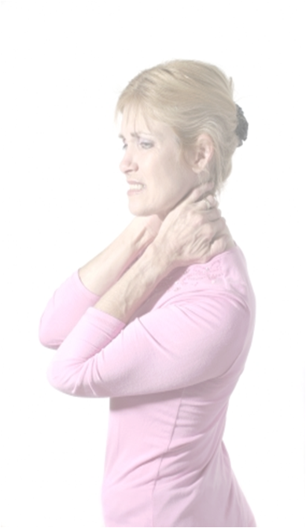
Acute ‘crick in the neck’ pain
  Acute neck pain with marked restricted motion (typically of rotation & sidebending to side of pain)
  Benign self-limiting condition that affects adults
  Typically involves trivial or no trauma
  Clinical signs of acute somatic dysfunction (TART)
May be an ideal condition to explore deep spinal structures for signs of inflammation

Slide 7
Aims of study
Examine the feasibility of recruiting subjects with acute neck pain of less than 48 hours duration
Investigate the cervical spine with MRI for inflammation and joint effusion in subjects with acute neck pain
Correlate abnormal MRI findings with palpatory findings

Slide 8
Methods
Inclusion criteria:
  Acute unilateral neck pain of less than 48 hours duration
  Physical examination confirms
    focal tenderness in cervical region
    painful limitation of full movement
Exclusion criteria:
  Recent history of major trauma (e.g. whiplash)
  Radiation of pain or neurological signs
  Previous diagnosis of cervical disc prolapsed
  Use of anti-inflammatory medication in the previous six hours
  Contraindications for MRI examination such as cardiac pacemakers & metal implants
  ATSU IRB Ethics approval

Slide 9
Procedure
Posters and e-mails for recruitment
  Necessary to create awareness of study so that individuals contact the researchers on the day of onset of pain
Physical examination
  Pain severity, current & worst (0-10 scale)
  Active range of motion (ranked on 0-3 scale)
  Side and spinal level of tenderness
  Segmental motion restriction (ranked on 0-2 scale)
Blinded MRI examination
  Same day
  Repeat in 2 weeks if positive findings

Slide 10
MRI examination
MRI imaging was performed with a 0.35-T MRI system (Signa Ovation: GE Medical Systems, Milwaukee, WI) using a dedicated phased-array C-T-L spine surface coil
Dedicated radiology PACS workstation (eFilm Workstation 3.0, Merge Healthcare, Milwaukee, Wis)
Board-certified diagnostic radiologist with added qualification and fellowship training in body imaging/ cross sectional (JA) with 13 years experience
MRI PROTOCOL
Sagittal images through entire neck – Fast spin-echo (FSE) STIR, repetition time (TR) 5400 milliseconds, echo time (TE) 28 milliseconds, inversion time 85 milliseconds, echo train length (ETL) 6, field of view (FOV) 280 millimeters, slice 5 mm/1 mm interspace, number of excitations (NEX) 3, and bandwidth 10.42 kHz.
Sagittal images through only the cervical spine – Fast Recovery FSE T2-weighted, TR 3450, TE 95, ETL 10, FOV 280, slice thickness 4.5 mm/0 mm interspace, NEX 3, and bandwidth 8.33.
Axial images from C2 to T1 – Series one: FSE STIR, TR 4250, TE 27, inversion time 80, ETL 6, FOV 260, slice 5 mm/0 mm interspace, NEX 3, and bandwidth 9.62. Series two: SE T1, TR 550, TE 11, FOV 260, slice 5 mm/0 mm interspace, NEX 3, and bandwidth 6.94

Slide 11
New Concepts Open MRI
Kirksville, Missouri

Slide 12
STIR – heavily T2 weighted, suppression of fat signal
Very sensitive for the detection of fluid
Sagittal FSE STIR (TR 5400, TE 28, inversion time 85 milliseconds (msec), echo train length (ETL) 6, FOV 280 mm, slice 5 mm/1 mm interspace, NEX 3, BW 10.42);

Slide 13
T2 weighted – sensitive for fluid & fat signal
Greater spacial resolution than STIR
Sagittal images through only the cervical spine - fast recovery fast spin-echo (FSE) T2-weighted (TR 3450, TE 95, ETL 10, FOV 280 mm, slice thickness 4.5 mm/0 mm interspace, NEX 3, BW 8.33);
Coronal images were used to assess sidebending

Slide 14
Axial images from C2 to T1 were FSE STIR (TR 4250, TE 27, inversion time 80 msec, ETL 6, FOV 260 mm, slice 5 mm/0 mm interspace, NEX 3, BW 9.62);
Axial T1 and STIR

Slide 15
Spin echo T1 - shows detailed anatomy, useful for problem-solving what tissues are made of. Fat is hyperintense, fluid hypointense
Spin echo T1 (TR 550, TE 11, FOV 260 mm, NEX 3, BW 6.94).

Slide 16
MRI analysis
Evidence of capsule or periarticular oedema and joint space T2 increase was recorded
  signs were to be ranked on a Berlin scoring system
Additionally, other signs recorded:
  muscle oedema
  alignment (lordosis, side bending)
  disc disease
  facet arthritic change
  spinal stenosis
MRI findings were correlated with
  Symptoms (side of pain, level)
  Palpatory findings (side of pain, level, restriction)

Slide 17
Results
Subjects
Five subjects were recruited over a 3-month period
  3 females, 2 males, Mean age 31.6 years (SD 12.4)
Symptoms
  Mean current pain = 4.8 (SD 1.6, visual analogue scale 0-10)
  Worst pain since onset = 7.0 (SD 0.7)
  Mean duration of symptoms = 12.4 hours (SD 14.1)
Subject | Side of Pain | Level of Pain | Current Pain | Worst Pain
1 | Left | All | 3 | 7
2 | Left | Upper | 6 | 8
3 | Right | Upper | 7 | 7
4 | Right | Lower | 4 | 6
5 | Left | Lower | 4 | 7
Mean (SD) |  |  | 4.8 (1.6) | 7.0 (0.7)

Slide 18
Results
Limited active motion
  Rotation to the painful side
  followed by side bending to the painful side and extension
Subject | Side Bending |  | Rotation |  | Flexion | Extension
 | Ipsilateral | Opposite | Ipsilateral | Opposite
1 | 1 | 0 | 0 | 1 | 1 | 0
2 | 2 | 0 | 2 | 0 | 1 | 0
3 | 3 | 1 | 2 | 0 | 1 | 3
4 | 1 | 1 | 2 | 1 | 3 | 2
5 | 2 | 2 | 2 | 2 | 3 | 2
Mean | 1.8 | 0.8 | 1.6 | 0.8 | 1.8 | 1.4
SD | 0.8 | 0.8 | 0.9 | 0.8 | 1.1 | 1.3
0-3 point scale: 0 = no restriction, 1 = mild restriction, 2 = moderate restriction, and 3 = marked restriction

Slide 19
Results
Palpation
  Most symptomatic segment varied from subject to subject
  Perceived degree of restriction at that segment varied from mild to markedly restricted
Subject | Side | Spinal Level | Restriction
1 | Left | C4 | 1
2 | Left | C2 | 2
3 | Right | C2 | 2
4 | Right | C6 | 1
5 | Left | C7 | 2
Mean (SD) |  |  | 1.6 (0.6)
Segmental motion restriction ranked on a 0-2 scale, where 0 = no restriction, 1 = mild restriction, and 2 = moderate restriction

Slide 20
MRI findings
No findings on MRI examination demonstrated clear evidence of either synovial effusion or inflammation around the joints of the cervical spine
In some individuals, signs of muscle oedema, altered alignment, disc and facet arthrosis, and spinal stenosis were noted

Slide 21
MRI findings
Subject | Muscle edema (signal increase) | Alignment Lordosis | Alignment Side Bending | Disc Degeneration | Facet Arthrosis | Spinal Stenosis
1 | Subtle increase right inferior paraspinals | Straightened mid cervical | Left, minimal | C5/6, mild bilateral | No | C5/6, mild central canal
2 | Subtle increase left trapezius and lower cervical region | Near straightened | Right, mild | C5/6, mild, worse right; C6/7, mild | No | C5/6 and C6/7, mild central canal
3 | Subtle increase left trapezius and lower cervical region | Kyphotic mid cervical | Left, mild | No | No | No
4 | Subtle increase left paraspinal region and mid neck | Kyphotic mid cervical | No | No | Mild uncinate arthrosis C6/7 | No
5 | Subtle increase right paraspinal and mid-upper cervical | Kyphotic mild lower cervical | No | C5/6, mild; C6/7, minimal | No | C5/6, mild central canal
  These did not appear to be related to the symptomatic segmental level or side of pain

Slide 22
T1
STIR
Subtle left trapezius muscle oedema
Notes:
The above attachments are an example of what appears to be subtle muscle edema. You have to put them side by
side. Then look at the left trapezius (on your right as you are facing the image). On the T1 you see the anatomy of the
muscle best on each side, and each is similar in hypointensity. On the STIR, the left muscle is subtly more
hyperintense relative to the right one (I windowed it kind of funky to try and show the edema a little better).

Slide 23
Assessment of sidebending from initial localizer images
Notes:
The sidebending was visible from the initial localizer images. The localizers are obtained quickly before all exams
begin so that we can see where the patient is within the machine prior to selecting where to obtain our slices. They
are gradient T1-weighted images, performed axially, sagittally, and coronally. They do not show great detail, but are
fine for showing sidebending on the coronal views. I attached an example from one subject (T.M.) which was straight,
versus another (E.D.) who had minor sidebending toward her left.

Slide 24
Disc degeneration, with posterior disc bulging greater at C5-6 than at C4-5. C5-6 has a right-central herniation

Slide 25
No signs of facet degeneration

Slide 26
Discussion
Very few researchers have attempted to investigate the deep structures of the spine in patients with pain for signs of inflammation
No study examined patients with acute pain
This feasibility study established that subjects with acute neck pain (less than 48 hours) could be recruited, albeit with difficulty and over a substantial period
Failed to find any indication of inflammation in the deep spinal structures using MRI

Slide 27
Zygapophysial joint has been implicated as a major pain generator in chronic cervical and LBP
Underlying etiology has not been determined
  Capsule sprain and tears demonstrated
  Association with acute or chronic neck or back pain unknown
Although sample size was small, no relevant signs of inflammation were found in any of the five subjects
Suggests that inflammation is not likely detectable using these methods even in a larger cohort
Consistent with findings of Nazarian et al.
  Ultrasonography less sensitive, subjects not acute
Cavanaugh JM, Lu Y, Chen C, Kallakuri S. Pain generation in lumbar and cervical facet joints. J Bone Joint Surg Am. Apr 2006;88
Bogduk N. Clinical Anatomy of the Lumbar Spine and Sacrum. 4th ed. New York: Churchill Livingstone; 2005
Nazarian LN, Zegel HG, Gilbert KR, Edell SL, Bakst BL, Goldberg BB. Paraspinal ultrasonography: lack of accuracy in evaluating patients with cervical or lumbar back pain. Journal of Ultrasound Medicine. 1998;17:117-122

Slide 28
Minor pathologies were detected in all subjects
No obvious relation to side and level of pain
Likely these pathologies were incidental and unrelated to the current presentation of pain or the findings on palpation
Consistent with evidence that
  Degree of cervical lordosis/ kyphosis cannot accurately identify ‘cervical muscle spasm’
  Degenerative changes observed in MRI are common in asymptomatic subjects and and are not well correlated with neck pain
Nordin M, Carragee EJ, Hogg-Johnson S, et al. Assessment of Neck Pain and Its Associated Disorders: Results of the Bone and Joint Decade 2000-2010 Task Force on Neck Pain and Its Associated Disorders. Spine. 2008;33(4S):S101-S122

Slide 29
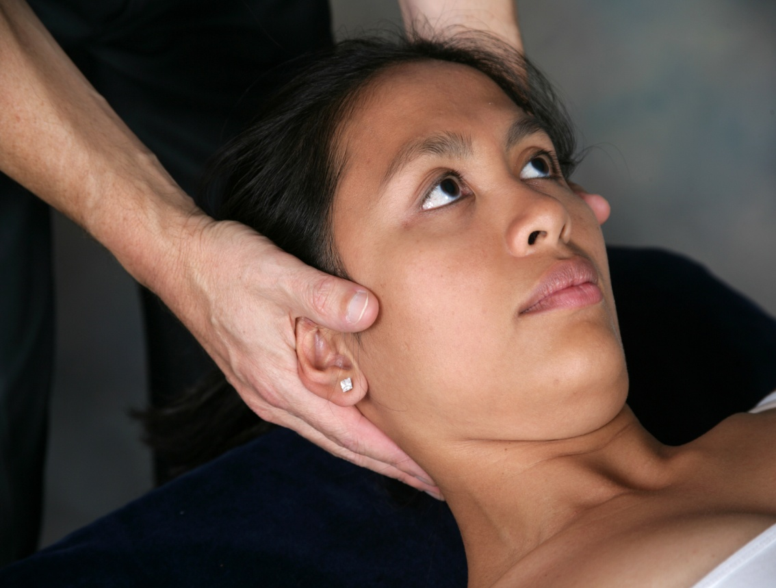
Palpation
Palpation of the most sensitive and restricted segment coincided with the side of pain and the region of symptoms in all subjects
Identified segment appeared markedly restricted with motion palpation in all cases
Lends support for the validity of palpation
Researcher was not blinded to the clinical picture of subjects
Concordance alone is therefore not convincing evidence of the reliability and validity of palpation

Slide 30
Feasibility of recruitment
Feasible, but difficult
  Within 48 hours of onset of pain
In order to achieve a larger sample:
  Create awareness of the study in a community
  Longer recruitment period
  Newspaper and radio advertising

Slide 31
Limitations & recommendations
Small sample size
Does not rule out inflammatory changes associated with acute neck pain
  Low grade sprains of much larger joints can be occult to MRI and other imaging
Imaging with higher field strength systems may possibly detect very subtle inflammation
  Tailored techniques at 3 Tesla (or even the ultra-high 7 tesla)
  Gadolinium IV-enhancement

Slide 32
Conclusion
Recruitment of subjects with acute ‘crick in the neck’ pain is difficult but feasible over a long data collection period
No evidence of cervical joint inflammation was detected
  a variety of degenerative features were identified which appeared incidental to the presenting complaint
If inflammatory changes exist in or around the cervical joints in subjects with acute neck pain, more sensitive imaging methods are required to detect it

Slide 33
Questions?

